Slide 1
Control types on variable displacement pumps
National Technical University of Athens School of Mechanical Engineering
Efstratios Tsolakis
Dipl. Mech. Eng. NTUA
Research Associate, Machine Design Lab
Athens,
27-03-2020

Slide 2
CONTENTS
Hydraulic pumps basics
Piston pump controls
Pressure compensator
Remote control
Load control
Other Types

Slide 3
Hydraulic Pump Basics
Hydraulic Pump Purpose :
Provide the Flow needed to transmit power from a prime mover to a hydraulic actuator.
Types of Hydraulic Pumps :
Centrifugal
Flow dependent on speed and outlet pressure
Primarily fluid transfer
Positive Displacement
Flow dependent on speed and displacement, independent of pressure
Primarily fluid power

Slide 4
Hydraulic Pump Basics
Hydraulic Flow is developed as the pump rotating group is driven by a prime mover
Fluid is forced out of pump at the pump outlet
A Partial vacuum is created at the pump inlet and atmospheric pressure forces fluid into pump from the reservoir

Slide 5
Hydraulic Pump Basics
POSITIVE DISPLACEMENT PUMPS
Displacement
Cubic meters (cc) per Revolution of drive shaft
Flow
Displacement X Shaft Speed X Volumetric Efficiency
Fixed Displacement
Flow varies only with shaft speed
Typical types Gear Pumps and Vane Pumps
Variable Displacement
Flow can be varied at a given shaft speed
Typical type is Variable Piston Pumps

Slide 6
Hydraulic Pump Basics
POSITIVE DISPLACEMENT PUMPS
Fixed Displacement
Good for constant flow and pressure applications
Typically less expensive than variable pump systems
Variable Displacement
Good for variable flow and / or pressure applications
Typically more energy efficient because flow and pressure ( Horsepower) more closely matches load.

Slide 7
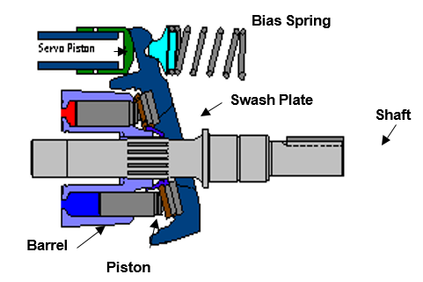
Hydraulic Pump Basics
Variable Displacement Piston Pump
Outlet Flow can be varied by changing the shaft drive speed, or by changing the swash plate angle.

Slide 8
Piston Pump Controls
Piston Pump Controls are integral valves that port flow to a stroking piston in response to a pressure or electronic signal , which results in a variable hydraulic pump achieving a desired displacement.

Slide 9
Piston Pump Controls
Common Variable Piston Pump Controls
Pressure Compensator
The pressure compensator control will limit pump outlet pressure to a predetermined level and adjust pump outlet flow to the level needed to maintain the set pressure.
Load Sense Control
Load sense control will adjust output flow to maintain a constant pressure drop across an orifice.
Torque Limiter Control
Will adjust flow to limit the input torque demand of the pump.
Electronic Displacement Control
Will adjust output flow in proportion to an electronic command.

Slide 10
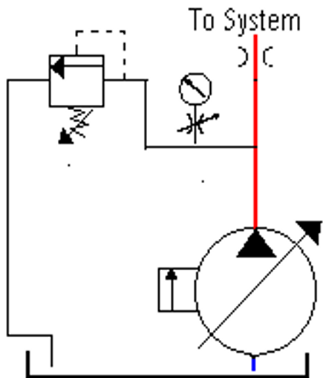
Pressure Compensator
Pressure compensated Pump will provide full pump flow at pressures below the compensator setting. Once the pump flow is restricted , pressure will build up to the setting of the compensator and then the pump will destroke to the level needed to maintain the compensator pressure setting

Slide 11
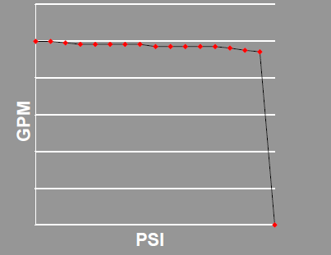
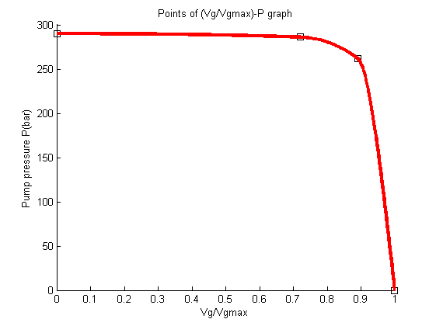
Piston Pump Controls
Standard Pressure Compensator
At pressures below the compensator setting, flow remains maximum.
When compensator setting is reached, the pump de-strokes to provide the flow required to maintain the set pressure. The pump will maintain maximum pressure until system pressure drops.
GPM
Lt/min
Bar

Slide 12
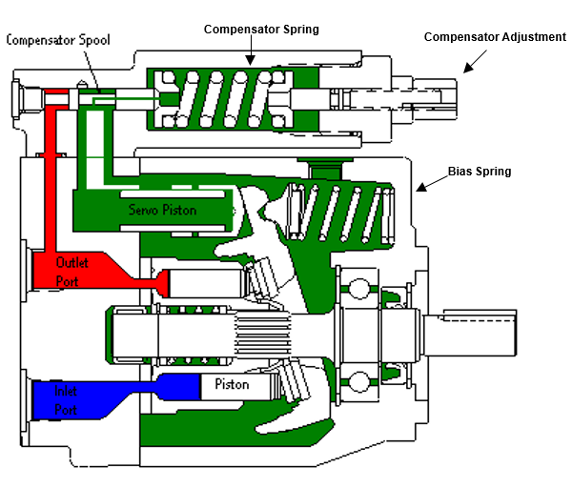
Pressure Compensator
Pump Pressure is below setting of control
Pump is at Full Stroke

Slide 13
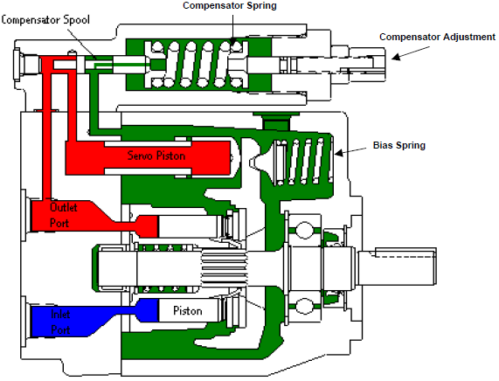
Pressure Compensator
Pump Pressure is above setting of control
Pump is at reduced Stroke

Slide 14
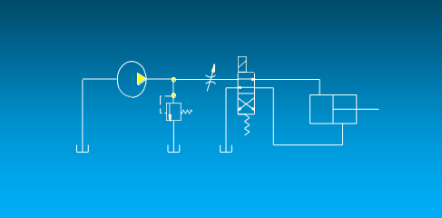
Piston Pump Controls
Problem
10 GPM Fixed Pump Relief Valve Set at 3000 PSI Flow Control Set for 5 GPM Load Pressure is 2000 PSI
What is the horsepower being consumed while the cylinder is extending ?
How much horsepower is being wasted ?
(HP = GPM * PSI / 1714
assume 100 % efficiency

Slide 15
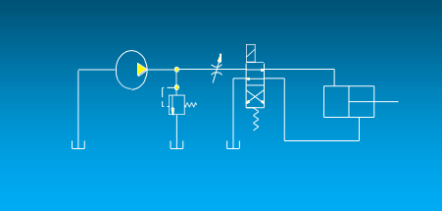
Piston Pump Controls
Problem
10 GPM Fixed Pump Relief Valve Set at 3000 PSI Flow Control Set for 5 GPM Load Pressure is 2000 PSI
What is the horsepower being consumed while the cylinder is extending ?
10 GPM * 3000 PSI / 1714 = 17.5 HP
How much horsepower is being wasted ?
5 GPM * 3000 PSI / 1714 = 8.7 HP
5 GPM * 1000 PSI / 1714 = 2.9 HP
Total= 11.6 HP
(assume 100 % efficiency)

Slide 16
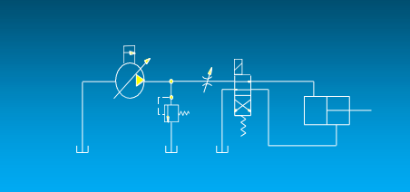
Piston Pump Controls
Problem
10 GPM Pressure Compensated Pump Pressure Compensator set at 3000 PSI Relief Valve Set at 3200 PSI
Flow Control Set for 5 GPM Load Pressure is 2000 PSI
What is the horsepower being consumed while the cylinder is extending ?
How much horsepower is being wasted ?
(HP = GPM * PSI / 1714
assume 100 % efficiency)

Slide 17
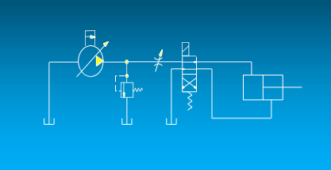
Piston Pump Controls
Problem
10 GPM Pressure Compensated Pump Pressure Compensator set at 3000 PSI Relief Valve Set at 3200 PSI
Flow Control Set for 5 GPM Load Pressure is 2000 PSI
What is horsepower being consumed while the cylinder is extending ?
5 GPM * 3000 PSI / 1714 = 8.7 HP
How much horsepower is being wasted ?
5 GPM * 1000 PSI / 1714 = 2.9 HP
(HP = GPM * PSI / 1714
assume 100 % efficiency)

Slide 18
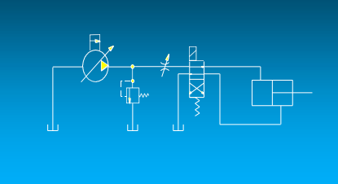
Piston Pump Controls
Problem
10 GPM Pressure Compensated Pump Pressure Compensator set at 3000 PSI Relief Valve Set at 3200 PSI
Flow Control Set for 5 GPM Load Pressure is 2000 PSI
What is horsepower being consumed while the cylinder is extending ?
5 GPM * 3000 PSI / 1714 = 8.7 HP
How much horsepower is being wasted ?
5 GPM * 1000 PSI / 1714 = 2.9 HP
(HP = GPM * PSI / 1714
assume 100 % efficiency)
Remember the Fixed Pump system used 17.5 HP and wasted 11.6 HP

Slide 19
Pressure Compensator

Slide 20
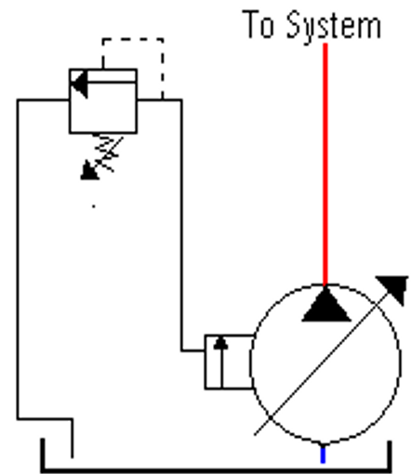
Remote Compensator
Remote compensator allows control of pump from a remote location from a relief valve located in a different location.

Slide 21
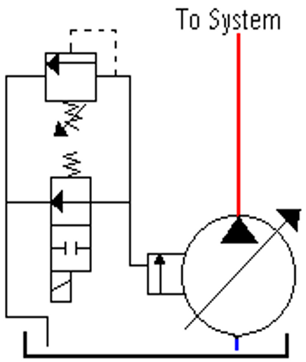
Remote Compensator
Remote compensator allows control of pump from a remote location. With addition of a 2 way valve the pump can be forced into a low pressure (differential spring) stand-by condition.
Less noisy (by 1/3), no heat from case drain, power savings

Slide 22
Piston Pump Controls
Remote Pressure Compensator
At pressures below the remote relief valve setting, flow remains maximum.
When relief valve setting is reached, the pump de-strokes to actual required (or zero) flow. The pump will maintain remote relief valve pressure until the system pressure drops.
PSI
GPM

Slide 23
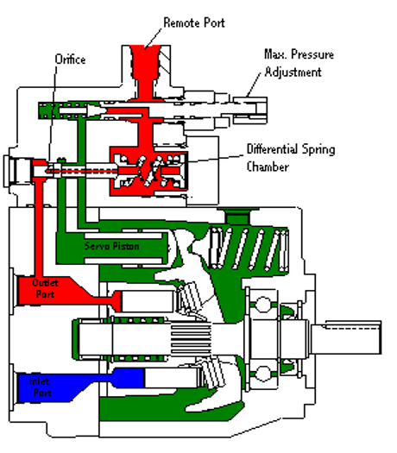
Remote Compensator
Just like a standard Pressure Compensator, except the pressure limiter adjustment is done with an external relief valve.
Pump Pressure is below setting of remote relief valve and below the setting of the poppet spring in the control . Pump is at Full Stroke

Slide 24
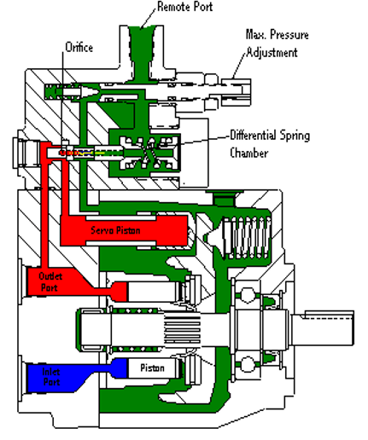
Remote Compensator
As Pump Pressure reaches setting of remote relief valve, the pressure in the differential spring chamber is limited and the spool shifts to destroke the pump.

Slide 25
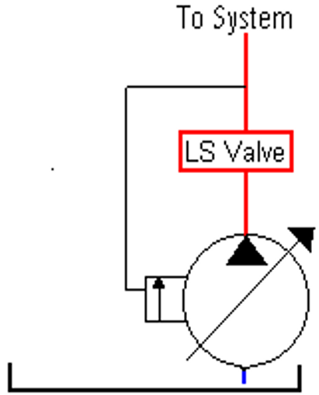
Piston Pump Controls
Load Sense Control
Load Sense control will match the output flow to the circuit demand at a pressure slightly above the load pressure.

Slide 26
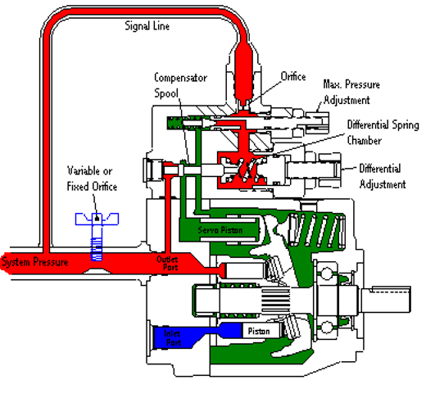
Load Sense Control
A load sense compensator will react to increases in the load by increasing output pressure. This is done by sensing the pressure drop across an external orifice and adjusting displacement to maintain a constant pressure drop across the orifice.

Slide 27
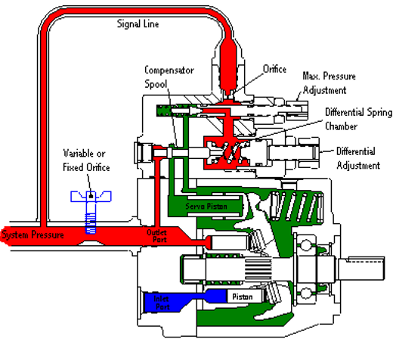
Load Sense Control
In this view the variable orifice is wide open and it is not restricting the pump flow. Pump outlet pressure and load pressure are equal. Since the pressure is equal on both sides of the spool, the differential spring keeps the spool to the left.
There is no control pressure in the servo piston , so the pump will stay at full stroke.

Slide 28
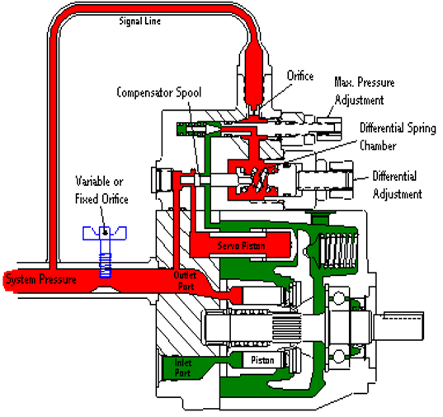
Load Sense Control
In this view the variable orifice is restricting pump flow . Pump outlet pressure is increased and a pressure drop is created across the orifice. The pump pressure will increase until it overcomes the differential spring force and shifts the spool to direct control oil into the servo piston and destroke the pump. The pump will maintain a flow level that keeps the pressure drop across the variable orifice constant
( equivalent to the differential spring setting)

Slide 29
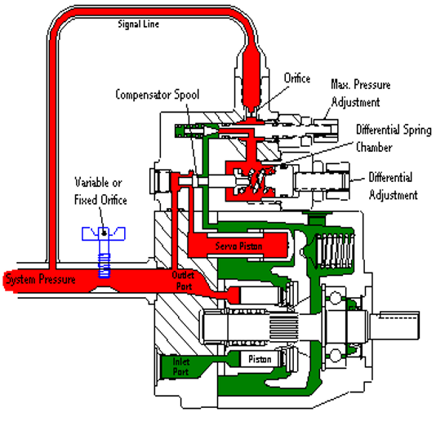
Load Sense Control
Since the load sense control will adjust pump flow to maintain the pressure drop across the orifice constant, increasing the orifice size will increase the flow to the system. Closing the orifice , will decrease the flow to the system.

Slide 30
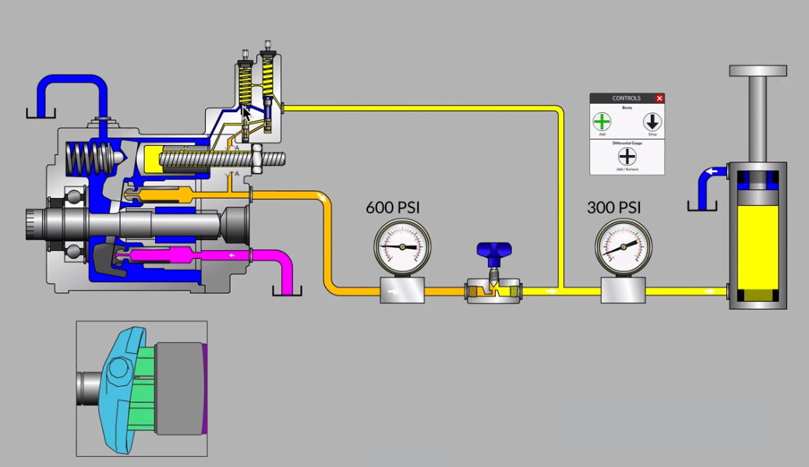
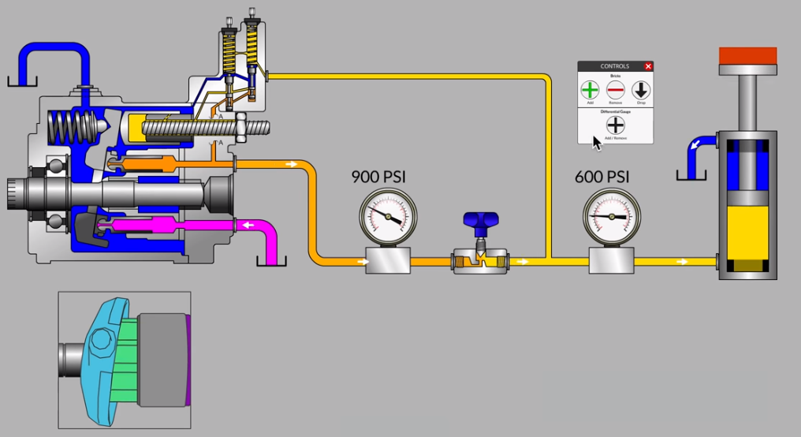
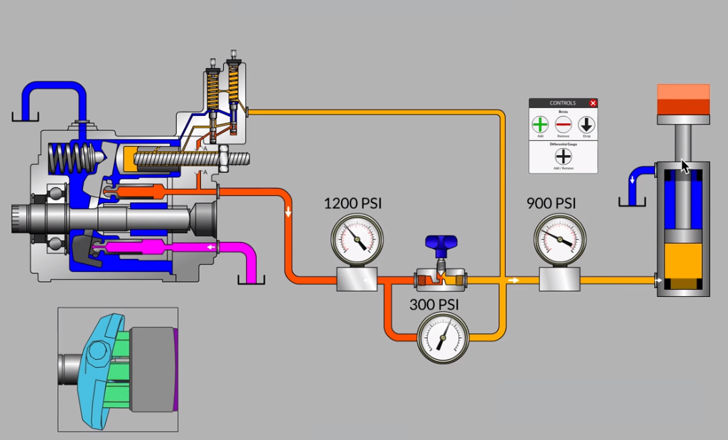
Load Sense Control

Slide 31
Piston Pump Controls
PSI
Load Sense Control
The load sense comp will increase or decrease the output flow to maintain a constant delta across the load orifice. This means that regardless of load conditions the flow will remain constant for a given orifice opening.
GPM

Slide 32
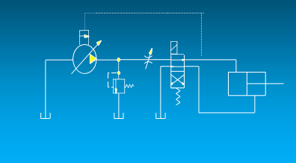
Piston Pump Controls
Problem
10 GPM Load Sense Pump Pressure Compensator set at 3000 PSI Load Sense Differential set at 200 PSI
Relief Valve Set at 3200 PSI Flow Control Set for 5 GPM Load Pressure is 2000 PSI
What is the horsepower being consumed while the cylinder is extending ?
How much horsepower is being wasted ?
(HP = GPM * PSI / 1714
assume 100 % efficiency)

Slide 33
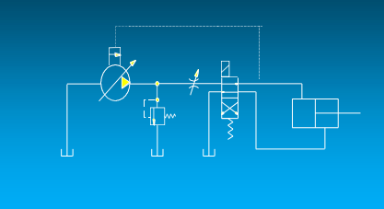
Piston Pump Controls
Problem
10 GPM Load Sense Pump Pressure Compensator set at 3000 PSI Load Sense Differential set at 200 PSI
Relief Valve Set at 3200 PSI Flow Control Set for 5 GPM Load Pressure is 2000 PSI
What is the horsepower being consumed while the cylinder is extending ?
5 GPM * 2200 PSI / 1714 = 6.4 HP
How much horsepower is being wasted ?
5 GPM * 200 PSI / 1714 = .6 HP
(HP = GPM * PSI / 1714
assume 100 % efficiency)

Slide 34
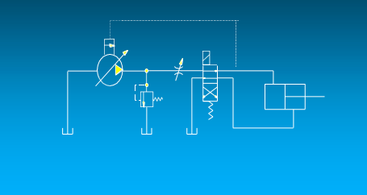
Piston Pump Controls
Problem
10 GPM Load Sense Pump Pressure Compensator set at 3000 PSI Load Sense Differential set at 200 PSI
Relief Valve Set at 3200 PSI Flow Control Set for 5 GPM Load Pressure is 2000 PSI
What is the horsepower being consumed while the cylinder is extending ?
5 GPM * 2200 PSI / 1714 = 6.4 HP
How much horsepower is being wasted ?
5 GPM * 200 PSI / 1714 =0 .6 HP
(HP = GPM * PSI / 1714
assume 100 % efficiency)
Remember the Pressure Compensatorsystem used
8.7 HP and wasted 2.9 HP

Slide 35
Load Sense Control

Slide 36
Load Sense Control
Good things to Know
Typical Load Sense Delta P setting is around 200- 300 psi
Standby Pressure is the pressure level the pump will maintain with no load sense signal. This is typically 50-100 psi higher than the Load Sense Delta P setting
Higher LS spring setting = faster response, but lower system efficiency
The load sense bleed option will vent the load sense signal to allow the pump to go to low pressure standby when there is no flow demand. This function is typically and best accomplished in the load sense system valve, but if the system valve does not have this feature, it can be ordered in the pump. The disadvantage of having the bleed in the pump is that there is a continuous loss of this bleed flow through the pump control even when the pump is operating normal.
When does Load Sense Make Sense ?
When there is a wide variation in flow requirements,
When there is a wide variation in pressure requirements .
When there is a need for constant flow , with variable input speed.

Slide 37
Thank you for your attention Questions?
Efstratios Tsolakis | Building: M
Machine Design Laboratory | NTUA Zografou Campus
Email: str.tsolakis@gmail.com etsolakis@central.ntua.gr | 9 Heroon Polytechniou Str. 15780, Zografou Athens
Tel: +30 210 772 3477 | Greece

